Slide 1
To be Worshiper
Trieu john

Slide 2
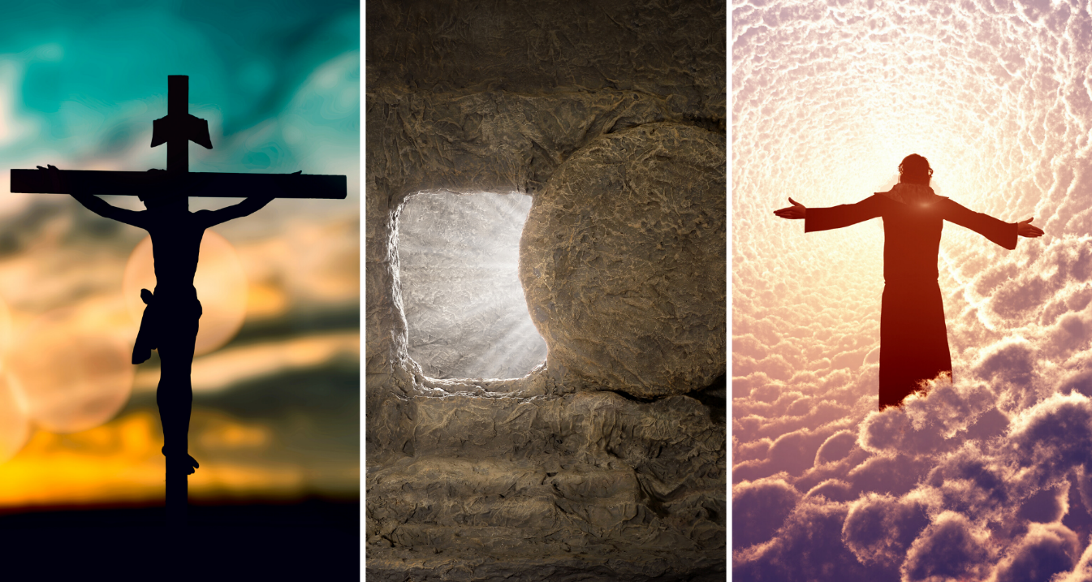
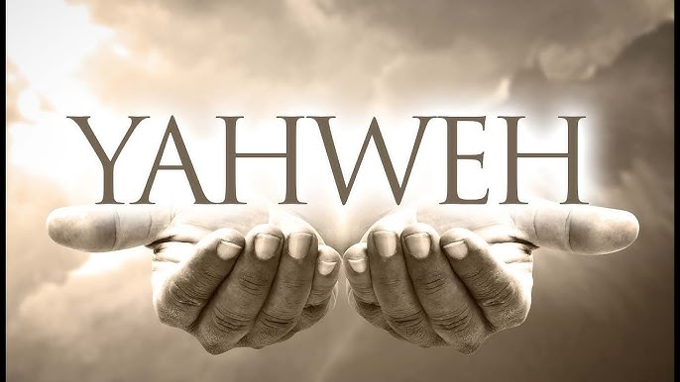
Agenda
Be Worshiper
The fact of worship nowadays
Understanding about worship
Be Worship Leader
Who am I?
What should I do?
Leading worship

Slide 3
The fact of the Church nowadays
To be worshiper
It certainly is true that hardly anything is missing from our churches these days — except the most important thing. We are missing the genuine and sacred offering of ourselves and our worship to the God and Father of our Lord Jesus Christ
Worship - A.W Tozer

Slide 4

Worship to You
To be worshiper
What does “worship” mean to you?
What is requirement to worship?
What are you doing to worship the LORD?

Slide 5
Some definitions
To be worshiper
“Biblical worship is an act of exalting God to a place of honor and reverence because He is worthy” – life, love & Jesus
“Worship is an expression of praise from the depths of our hearts toward a God who is understood through His Word. If we do not have the truth of the Bible, we do not know God and we cannot be truly worshiping.” – got Questions

Slide 6
True Worshiper
To be worshiper
The truth of the LORD:
“But the hour is coming, and now is, when the true worshipers will worship the Father in spirit and truth; for the Father is seeking such to worship Him. God is Spirit, and those who worship Him must worship in spirit and truth. ”
– John 4:23-24

Slide 7
True Worshiper
To be worshiper
The truth of the LORD:
“But the hour is coming, and now is, when the true worshipers will worship the Father in spirit and truth; for the Father is seeking such to worship Him. God is Spirit, and those who worship Him must worship in spirit and truth. ”
– John 4:23-24

Slide 8
How the term “worship” is used in New Testament?
To be worshiper
“But the hour is coming, and now is, when the true worshipers will worship the Father in spirit and truth; for the Father is seeking such to worship Him. God is Spirit, and those who worship Him must worship in spirit and truth. ”
– John 4:23-24

Slide 9
John 4:19-26
To be worshiper
¹⁹“Sir,” the woman said, “I can see that you are a prophet. ²⁰Our ancestors worshiped on this mountain, but you Jews claim that the place where we must worship is in Jerusalem.”
²¹ “Woman,” Jesus replied, “believe me, a time is coming when you will worship the Father neither on this mountain nor in Jerusalem.

Slide 10
John 4:19-26
To be worshiper
²²You Samaritans worship what you do not know; we worship what we do know, for salvation is from the Jews.
²³Yet a time is coming and has now come when the true worshipers will worship the Father in the Spirit and in truth, for they are the kind of worshipers the Father seeks.²⁴God is spirit, and his worshipers must worship in the Spirit and in truth.”

Slide 11
John 4:19-26
To be worshiper
²⁵The woman said, “I know that Messiah” (called Christ) “is coming. When he comes, he will explain everything to us.”
²⁶Then Jesus declared, “I, the one speaking to you—I am he.”

Slide 12
What does “spirit” mean?
To be worshiper
“But the hour is coming, and now is, when the true worshipers will worship the Father in spirit and truth; for the Father is seeking such to worship Him. God is Spirit, and those who worship Him must worship in spirit and truth. ”
– John 4:23-24

Slide 13
How the term “worship” is used in Old Testament?
To be worshiper
The presence of the LORD:
“Exalt the Lord our God, And worship at His holy hill; For the Lord our God is holy.”
- Psalm 99:9
“You shall not worship the Lord your God with such things. But you shall seek the place where the Lord your God chooses, out of all your tribes, to put His name for His dwelling place; and there you shall go.” – Deuteronomy 12:4-5

Slide 14
How the term “worship” is used in Old Testament?
To be worshiper
The nature of the LORD:
“Give unto the Lord the glory due to His name; Worship the Lord in the beauty of holiness.”
- Psalm 29:2

Slide 15
How the term “worship” is used in Old Testament?
To be worshiper
The nature of the LORD:
“I will worship toward Your holy temple, And praise Your name For Your lovingkindness and Your truth;
For You have magnified Your word above all Your name.”
- Psalm 138:2

Slide 16
The action of worship
To be worshiper
The nature of the LORD:
“I will extol the LORD at all times; his praise will always be on my lips.”
- Psalm 34:1

Slide 17
Summary from the text
To be worshiper
“But the hour is coming, and now is, when the true worshipers will worship the Father in spirit and truth; for the Father is seeking such to worship Him. God is Spirit, and those who worship Him must worship in spirit and truth. ”
– John 4:23-24

Slide 18
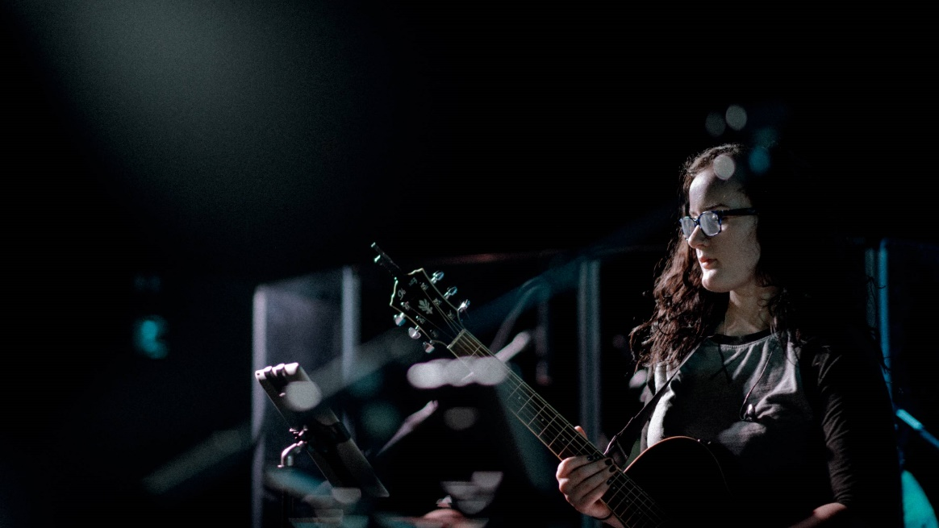
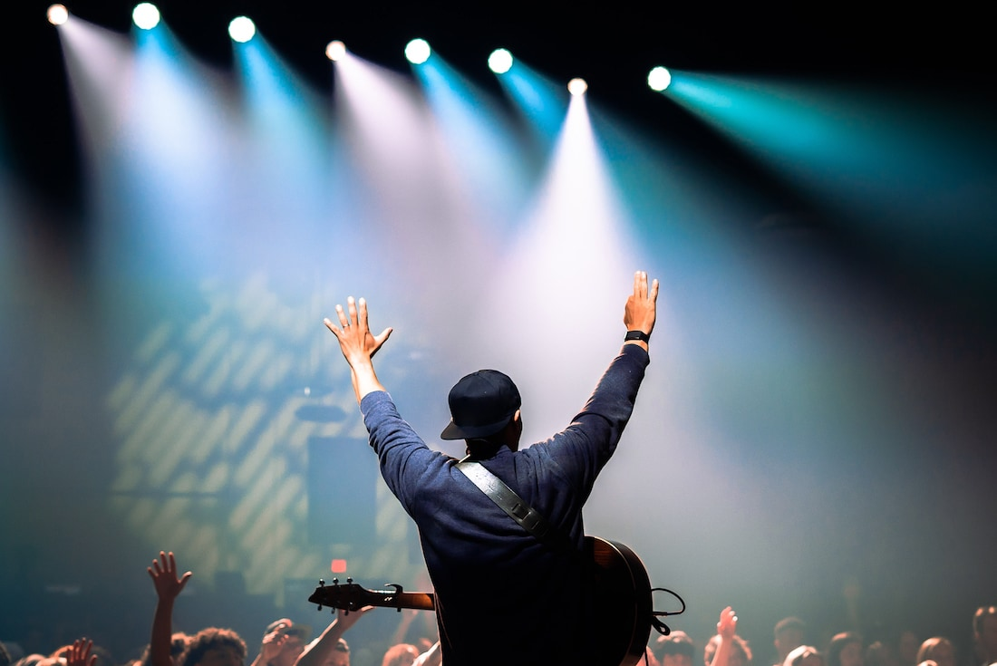
Who is worship leader?
Worship Leader

Slide 19
Life as a Worship Leader
To be worshiper
“Becoming a worship pastor or worship leader is a calling. If you are looking to lead people toward a more fulfilling relationship with God, then you should consider a career as a worship leader. Being a worship leader is about helping the people in your congregation grow closer to God through music, worship and community.. ”
- Grand Canyon University

